Slide 1

Coding Guidelines

Slide 2
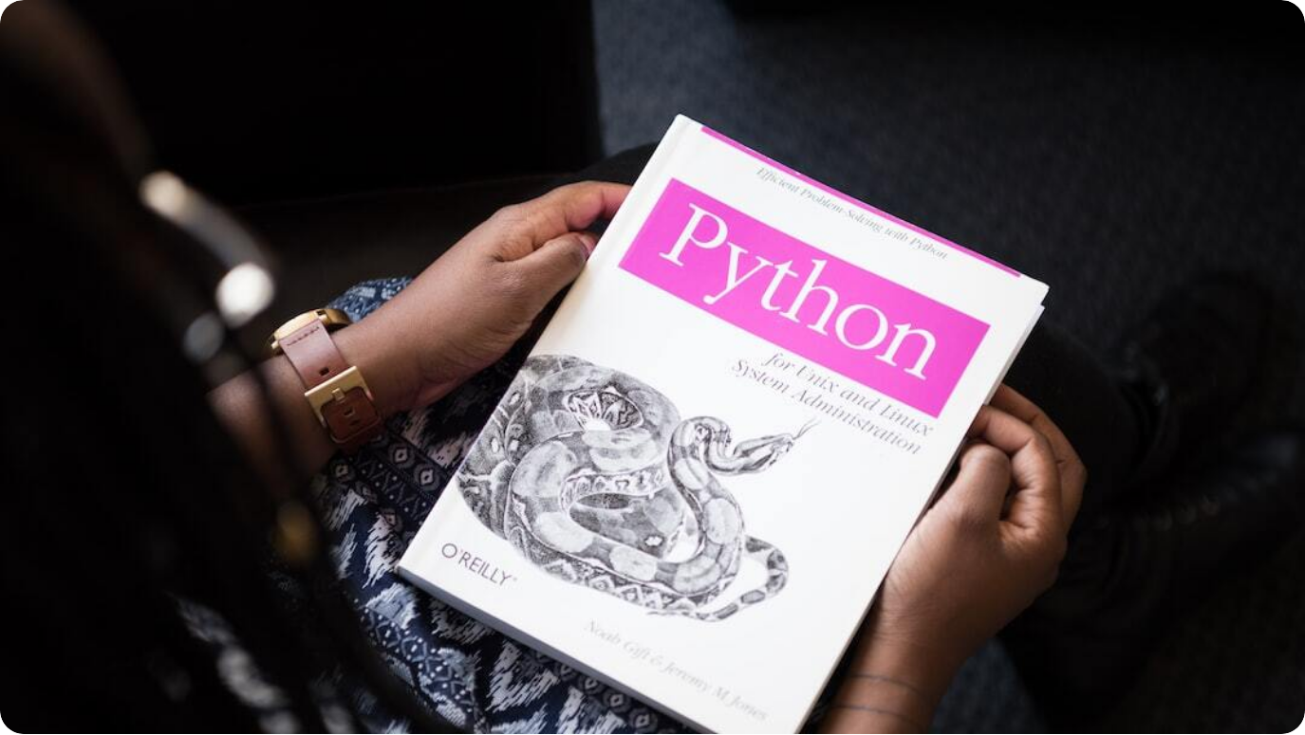
Coding Guidelines: Python
Importance of Coding Standards: Establishes a common structure and improves collaboration, readability, and maintainability across projects.
Python’s Strengths: Valued for its simplicity, readability, and comprehensive libraries which support rapid development.
Purpose of Guidelines: Promotes clean, efficient, and Pythonic code with adherence to modern development norms.
Notes:
Python is celebrated for its elegance and ease of use, but without consistent standards, even Python projects can become tangled and difficult to maintain. The DTS Coding Guidelines aim to address this by promoting disciplined coding practices that ensure everyone in a team writes clean, readable, and maintainable code.
By aligning with Python’s strengths—like its rich standard library and readability—these guidelines not only foster better collaboration but also reduce bugs and technical debt. Whether you're a new developer or a seasoned engineer, adhering to these best practices makes your contributions more impactful and future-proof.
This introduction lays the foundation for deeper topics like structure, style, testing, and security that follow in the presentation.

Slide 3
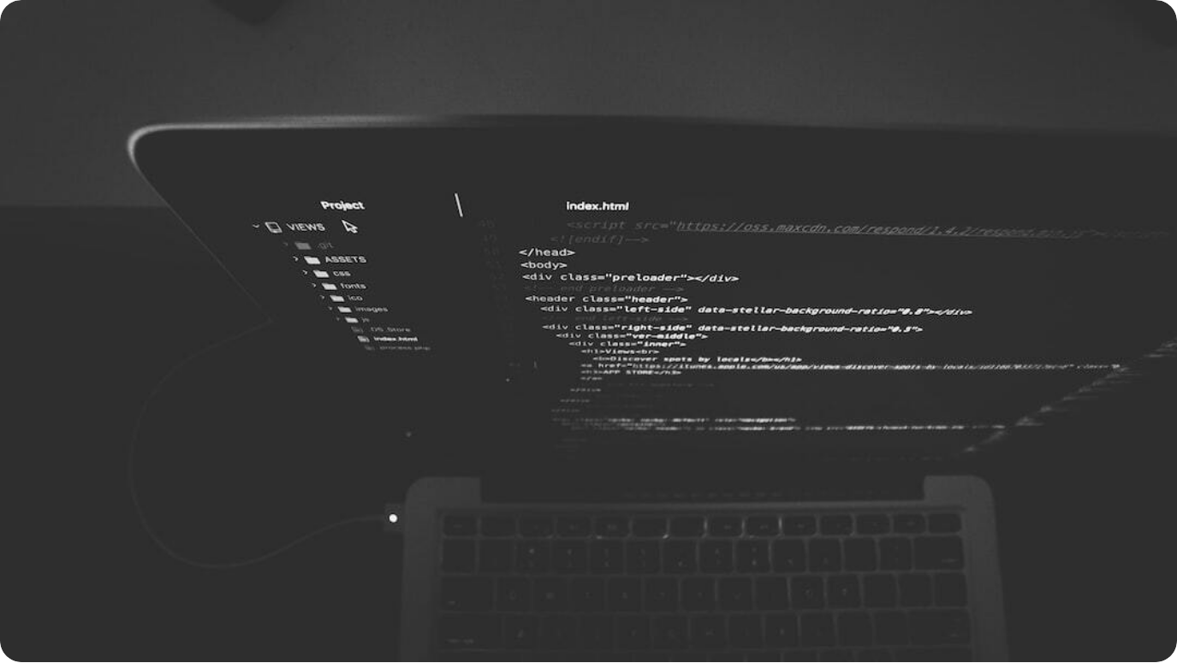
Code Structure Principles
Maintaining Readable and Organized Python Code
Indentation: Use 4 spaces for consistency; avoid tabs to prevent visual errors across editors.
Whitespace: Ensure clarity with single spaces around operators and avoid clutter from excessive spacing.
Import Order & Organization: Structure imports: standard libraries, then third-party packages, followed by local modules.
Notes:
A well-structured Python codebase begins with attention to formatting. Indentation is not just stylistic in Python—it's syntactic. Using four spaces is the community standard and ensures uniformity across environments.
Whitespace is another deceptively powerful tool. Proper spacing makes logic more readable, while overuse leads to confusion. And just like a well-curated library, imports must follow a clear hierarchy. This promotes clarity and prevents namespace collisions, which is critical as codebases grow.
By following these foundational practices, we lay the groundwork for readable, reliable, and collaborative Python development.

Slide 4
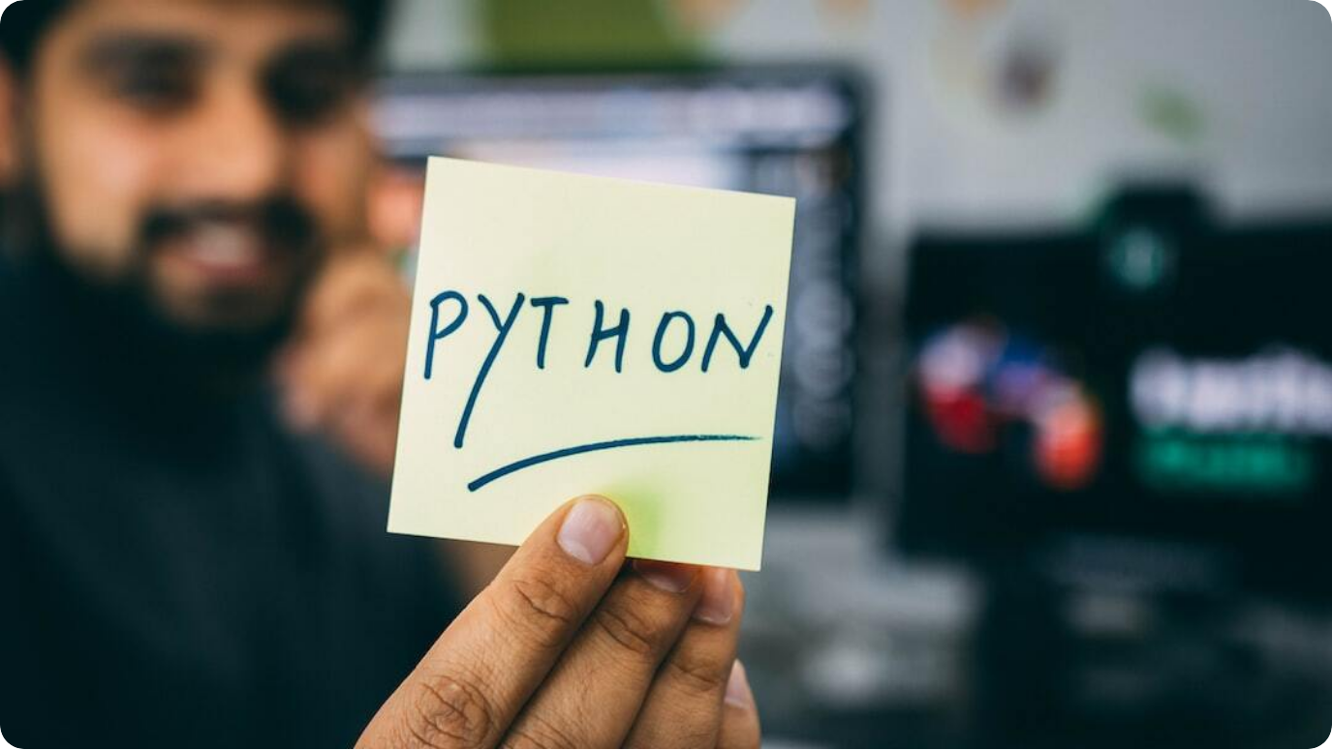
Coding Style: PEP 8 & Naming Conventions
Writing Pythonic and Readable Code
PEP 8 Compliance: Follow Python’s official style guide for consistent formatting and readability.
Descriptive Naming: Use meaningful names with snake_case for variables/functions and CamelCase for classes.
Automated Style Checks: Utilize tools like flake8 or pylint to enforce adherence automatically.
Notes:
Python’s elegance shines when developers write code that's as intuitive to read as it is to execute. PEP 8 is the community's formal style guide, emphasizing clarity, simplicity, and consistency. Adhering to it ensures everyone on a team interprets and navigates the code the same way.
Naming conventions are also essential: meaningful identifiers and consistent casing reduce ambiguity. Variables and functions use snake_case, while classes adopt CamelCase.
Modern teams rely on tools like flake8 or pylint to automate compliance, reducing the manual overhead of code reviews and promoting clean, standardized code across projects.

Slide 5
Error Handling & Logging
Robust Handling of Exceptions in Python
Granular Exception Handling: Catch specific exceptions to prevent unintended errors and maintain clarity.
Logging Over Printing: Use Python’s logging module with levels like DEBUG and ERROR instead of print statements.
Structured Error Responses: Respond to exceptions meaningfully, especially in production environments.
Notes:
Handling errors gracefully is a hallmark of resilient software. Instead of using broad exception handling, Python developers are encouraged to catch specific exceptions. This prevents masking bugs and keeps the root cause visible.
Moreover, using the logging module provides both flexibility and structure. You can filter logs by severity, direct them to files or monitoring systems, and maintain clean console output.
In high-stakes or production environments, structured error messages are critical. They help with debugging, improve user experience, and support downstream tools that parse logs. Mastering these techniques boosts both the stability and maintainability of your Python projects.

Slide 6



Data Structures in Python
Leveraging Built-in Structures for Efficient Code
Lists & Comprehensions
Use list comprehensions for concise, performant iteration and transformation.
Sets & Dictionaries
Prefer sets for uniqueness and dictionaries for key-value mappings with fast lookups.
Tuples for Immutability
Use tuples for fixed data and unpack for readability.
Notes:
Python offers rich and versatile data structures built into the language, enabling developers to write expressive and optimized code with minimal boilerplate. Lists are the most flexible structure and become even more powerful with list comprehensions, allowing transformations in a single readable line.
When uniqueness or fast membership tests are needed, sets are ideal. Dictionaries shine for structured data with constant-time access by keys. These structures are foundational for efficient algorithms.
Tuples, while similar to lists, are immutable. They’re perfect for fixed collections of data and make code cleaner when used with unpacking. Mastery of these tools ensures your code remains lean, elegant, and performant.

Slide 7


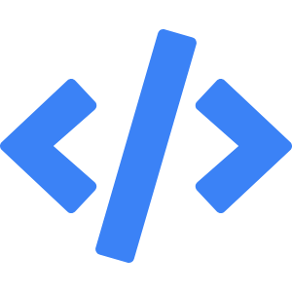
Functions: Parameters, Returns & Lambdas
Building Modular and Reusable Python Code
Minimal Parameters
Limit parameters (ideally ≤3) and use defaults to simplify usage.
Explicit Return Values
Return clear, meaningful results; avoid flag-based returns.
Use of Lambdas
Employ lambda functions for concise operations but avoid complexity.
Notes:
Functions are the fundamental unit of logic in Python, and designing them with clarity and reusability in mind is essential. Start by minimizing the number of parameters. If a value is optional, assign it a default—this enhances both readability and usability.
Avoid vague or overloaded return values. Instead, return well-named variables or structured data that clearly conveys intent. This helps other developers (and your future self) understand what a function does at a glance.
Lambdas are powerful for brief operations—like mapping or filtering—but should be avoided for anything complex. They should clarify, not obscure, your logic. These practices lead to code that’s easy to test, reuse, and reason about.

Slide 8
Documentation Practices
Clarity Through Docstrings and README Files
Use of Docstrings: Document modules, classes, and functions using clear triple-quoted docstrings.
README Importance: Each project should include a README explaining purpose, usage, and dependencies.
Installation & Usage: README must contain installation steps, usage examples, and contribution guidelines.
Notes:
Documentation is the gateway to understanding a codebase. Python promotes docstrings as the standard for in-code documentation. Every module, function, and class should include a clear docstring that describes its purpose, parameters, and return values.
The README file acts as the public-facing overview of the project. It’s vital for onboarding, open-source visibility, and internal collaboration. At a minimum, it should describe what the project does, how to install dependencies, and how to use the application or library.
For collaborative projects, including contribution instructions and licensing details fosters open participation and clarifies responsibilities. Clear documentation turns good code into usable, shareable software.

Slide 9



Testing and Test Coverage
Ensuring Code Reliability Through Automation
Unit Testing
Use unittest or pytest to validate critical functions and catch regressions early.
Continuous Testing
Automate tests in CI pipelines to ensure consistent code quality.
Measure Coverage
Use tools like coverage.py to ensure all major code paths are tested.
Notes:
Testing is not optional—it's essential for any serious software development effort. Python provides robust testing tools, with unittest built-in and pytest widely adopted for its simplicity and power. Writing tests for core functions ensures they behave as expected and catch regressions before they reach production.
For larger teams, integrating tests into a CI/CD pipeline ensures code is automatically validated with each commit. This fosters a test-driven culture and improves overall code discipline.
Test coverage tools like coverage.py quantify how much of your code is actually being exercised by tests. This helps you identify blind spots and reinforce confidence in your application's stability.

Slide 10



Performance Optimization
Efficient Code in Terms of Time and Memory
Time Complexity Awareness
Choose efficient algorithms based on Big O analysis for scalable performance.
Memory-Efficient Coding
Use generators and lazy evaluation to avoid memory overload.
Avoid Redundancy
Refactor loops and operations to eliminate unnecessary computations.
Notes:
Writing fast and memory-efficient Python code isn't just for high-performance systems—it's crucial for any modern software handling growing data or user loads. Start with time complexity. Understanding algorithmic behavior helps you choose optimal solutions, especially in nested loops or recursive functions.
Memory usage often goes unnoticed until it becomes a bottleneck. Using generators instead of building large lists allows lazy evaluation—processing one item at a time without exhausting RAM.
Finally, avoid computational redundancy. Whether it’s caching repeated results or restructuring a loop, small changes can significantly impact speed and responsiveness. Optimization is both an art and a science in Python.

Slide 11



Security Best Practices
Validating Input and Handling Passwords Safely
Input Validation
Always sanitize and validate input to prevent injection and type errors.
Secure Password Storage
Use cryptographic hashing (e.g., SHA-256) with salts to protect passwords.
Raise Errors Intentionally
Throw exceptions when data violates security expectations.
Notes:
Security in Python isn't about avoiding risk—it's about managing it proactively. The first line of defense is input validation. Whether you're accepting user data from forms, APIs, or files, always verify its type, range, and intent to prevent injection and other attacks.
Password management is another critical area. Never store passwords in plain text. Use cryptographic hashing algorithms with added salts to defend against common attack vectors like rainbow tables.
Lastly, error handling plays a security role too. If invalid data sneaks past validation, raise errors deliberately. This ensures unsafe paths are not silently executed, preventing logic corruption or exposure of sensitive logic.

Slide 12



Collaboration & Workflow
Version Control, Reviews, and CI/CD Integration
Git for Version Control
Track changes, isolate features via branches, and ensure traceability.
Peer Code Reviews
Foster knowledge sharing and catch bugs with structured feedback.
Continuous Integration (CI)
Automate testing and linting via GitHub Actions or similar tools.
Notes:
Team collaboration is more than just communication—it's about building a resilient process. Version control using Git enables structured workflows, allowing teams to branch out, experiment, and merge changes methodically.
Code reviews aren't just for catching errors—they're opportunities for mentorship, discussion, and enforcing standards. Providing constructive feedback ensures quality and alignment across the codebase.
Continuous Integration (CI) takes these practices further. Tools like GitHub Actions can automatically run tests, lint code, and verify builds with every commit. This enforces discipline and keeps the master branch stable—every developer’s dream.

Slide 13


Conclusion & Best Practice Recap
Sustaining High-Quality Python Development
Consistency Matters
Following standardized practices boosts readability and team productivity.
Security & Performance
Guard against vulnerabilities and optimize for speed and memory.
Documentation & Testing
Clear docs and strong tests are the backbone of sustainable code.
Notes:
In wrapping up the DTS Coding Guidelines, the message is clear: high-quality Python code emerges from consistent, disciplined practices. Every choice—from indentation to error handling—has implications for maintainability and clarity.
Security isn't just a backend concern; it's integral at the function level. Similarly, performance should be factored into every loop and data structure decision. Developers should always ask, 'Can this be done better?'
And finally, documentation and testing are not optional. They’re what keep your code understandable, verifiable, and future-proof. Adopt these guidelines not just as rules but as habits. That’s how great Python developers build great software.

Slide 14
Thank You

